Slide 1
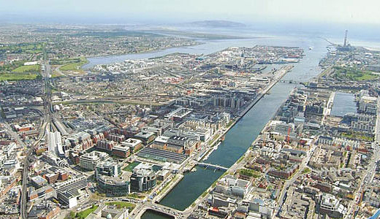
Dublin: North East Inner City
"Creating a Brighter Future"
An Outline Plan for the Social and Economic Regeneration of Dublin's North Inner City

Slide 2
Purpose of Today & Next Steps
So far......
Draft report significantly advanced but not finalised
Ministerial Taskforce presentation on 21st December – similar outline today
Today another opportunity to input to the final report
    Give feedback on emerging themes
    “Sense-check” emerging priority areas
    Identify any apparent gaps

Slide 3
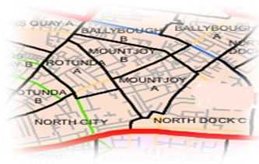
The Task
Visiting the area and meeting local community, service providers and statutory services
Reviewing Wide Range of Submissions
Gathering Information on Funding and Services
CSO Census Data and Pobal Deprivation
Learning lessons – NESC work
Reporting periodically to the Ministerial Taskforce

Slide 4
The Approach
Inputs
  Wide consultation and engagement with the community, individuals, groups and advocates
  Use data / evidence to inform – what the issues are, what’s working here, what’s worked elsewhere....... what isn’t/what doesn’t .....
What I am seeking to achieve in final report:
Look to “fix” certain immediate issues but primary focus on rebuilding and creating foundations for the future
Capture and identify community assets and resilience, avoiding a “deficit” model
Be honest about what is challenging for/within the community
Be ambitious but a devise plan that is feasible to implement
Be respectful but challenging to the “system”, the Government, but also the community at every level

Slide 5
Overview
A COMMUNITY RICH IN ASSETS WHICH IS NOT REACHING ITS POTENTIAL
COMMUNITY WHICH IS ASSET–RICH, INCREASINGLY DIVERSE, AFRAID OF “FALSE DAWNS"
GREAT PEOPLE & LEADERS COPING WITH HIGH LEVELS OF CRIME AS PART OF DAILY LIFE
SIGNIFICANT LEVELS OF SERVICES BUT POORLY CO-ORDINATED AND SOME GAPS
SCHOOLS EDUCATION TRAINING STRONG BUT LINKS TO EMPLOYMENT & LOCAL BUSINESS INSUFFICIENT
SPORTS, ARTS & HERITAGE OPPORTUNITIES NOT FULLY VALUED OR MINED
URBAN LANDSCAPE OF BUILDINGS AND STREETS POTENTIAL UNREALISED

Slide 6
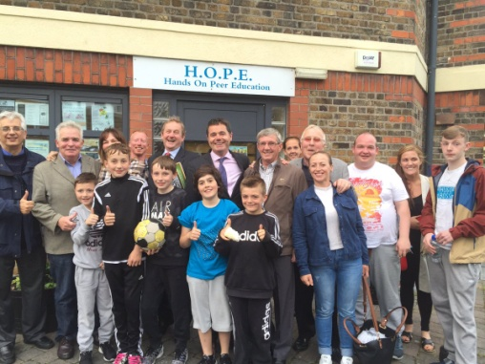
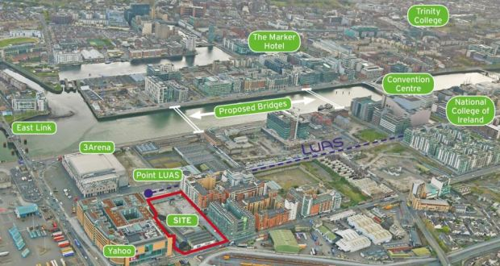
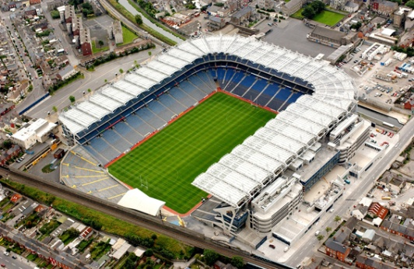
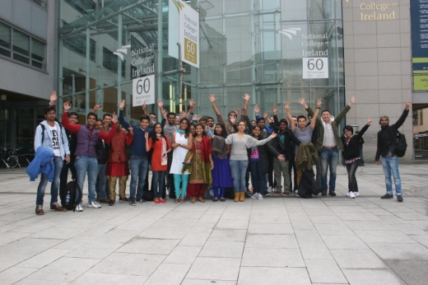
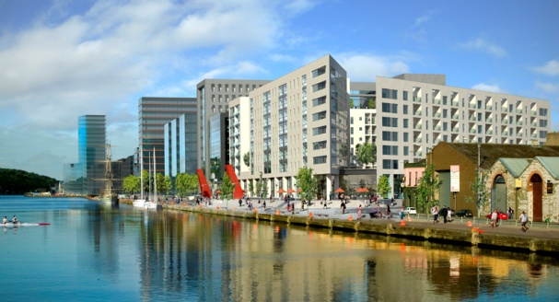
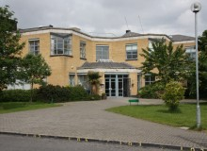
Opportunities
People
People & Community
City location and Infrastructure
Services - Schools, Colleges
Investment
Investment
NCI
Schools

Slide 7
Challenges
Criminality and Drug Culture
Changing the narrative
Re-imagining the area
Improve Coordination - Multiplicity of Services
Measuring and investing in what works
New generation of leaders
Inspiring and equipping the next generation
Community, Business, Statutory Agencies as partners

Slide 8
Delivering Change – Vision and Principles
Vision
Making the North Inner City a safe, attractive and vibrant living and working environment for the community and its families with opportunities for all to lead full lives
Principles
New and tailored focused approach needed
Community-led and driven
Connected to existing structures and national policies
4 Key Areas for Priority Action

Slide 9
1. Policing and Crime Prevention
Key Actions
Make Fitzgibbon Street Garda Station a centre for community policing.
  Increase the levels of visible and consistent policing presence
  Strengthened focus on local drug enforcement
  A local asset profiling service feeding into CAB
  A “community” space within the Station
  Adequate CCTV coverage of key locations
  An enhanced community policing plan using“small area” model
Community engaged and empowered
  The Community Policy Forum working with a refreshed community engagement model.
  events and activities to build cross-community cohesion, tackle intimidation and make it safe to lead
  A public awareness campaign to promote the Drug Related Intimidation Reporting Programme
Integration of targeted approaches to at-risk young people
  alternative pathways from criminality
  youth leadership programme
  records

Slide 10
2. education / training / Local Employment Opportunities – key Actions
NEIC Learning and Employment Forum to connect all education, training and jobs initiatives
  skills need assessment to inform training requirements
  strengthen links with business and employers
Strengthen and Unify existing service provision
  develop a single accessible map of available services
  examine the scope for greater flexibility
  alignment of third level access programmes
New dedicated career guidance outreach service building on and enhancing existing provision
    linking local young people with local training and jobs
  Devise a framework for community benefits for local developments in the area
  Third level educational opportunities

Slide 11
3. Creating an integrated system of social services – Key Actions
Specialist hub for highly vulnerable families bringing a range of services providers together
More Integrated Youth Services
Local Early Years : intensive supports, transition
Schools – network, collaboration, DEIS pilots
Improved Social Cohesion and Collaboration
Drug Services – link between National Drugs Strategy and local needs identified; funded support programmes
Sports, Arts and Heritage – leverage additional programmes

Slide 12
4. Improving physical landscape
Key Actions
Rebrand and Re-imagine the Area
complete immediate physical improvement works
Develop a comprehensive refurbishment plan and explore various options to fund it
Target derelict sites and illegal dumping
Encourage continued business and residential developments beyond the SDZ

Slide 13
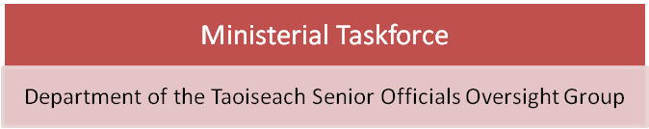
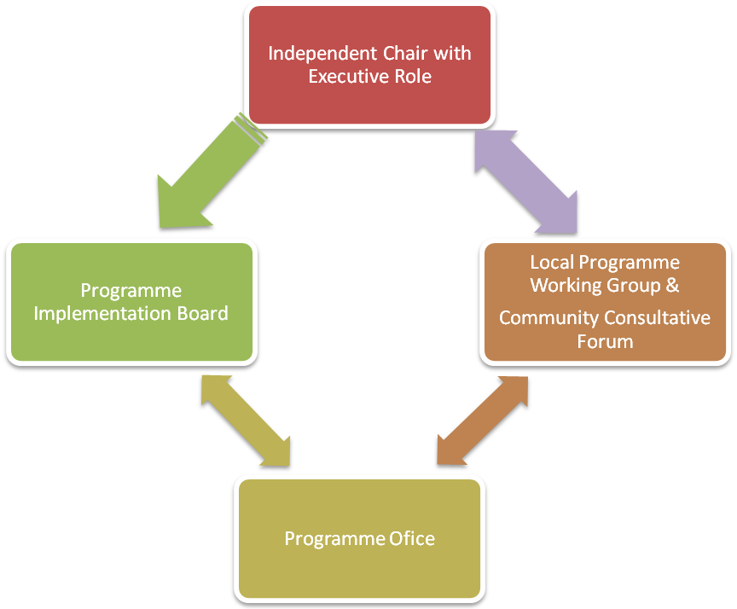
Effective Implementation and Delivery Structure
Programme Implementation Board will include:
Community representatives
Dublin City Council
Statutory Agencies
Businesses
Independent Executive Chair Role will include:
Chair of the Programme Implementation Board
Chair of the Local Programme Working Group
Executive functions as Programme Office Director on a part-time basis
Member of the Senior Officials Oversight Group reporting to the Ministerial Taskforce

Slide 14
Feedback
Assessment of the Challenge / the Assets?
  Accurate
  Anything missing
Assessment of the Priority Areas
  Are these the right areas?
  Are there any key pieces/actors missing?
Implementation
  What is the key to successful implementation from the community’s point of view?
What else?
  What other issues are “burning” that I need to know about and reflect on in the Report?

Slide 15
Next Steps
Discussion and feedback from Local Community today
Completion of the final report and submission to Ministerial Taskforce shortly

